Slide 1
10 bits Successive Approximation Register ADC
Supervised By
Dr. Ibrahim Abdalla
Made By
Basant Moheb El-malky

Slide 2

Technology: 45 nm CMOS
Power Supply: 1.2v
Resolution: 10bits
Sampling Rate: 100MS/S
Common-Mode Voltage: 0.6v
Differential Input Range: 0.8v – 0.95v
SINAD: 60 dB
MiM Cap: 15fF
SFDR: 75 dB
ENOB: 9.8 bits
Test Frequency: 49.12MHZ
Power: < 1mw

Slide 3
Architecture of SAR ADC with Low Dropout Regulator
V
IN
Sample-And-Hold
synchronous SAR Logic
D
OUT
Comparator
N-bit
DAC

Slide 4
Architecture of SAR ADC with Low Dropout Regulator
V
IN
Sample
-And-Hold
synchronous SAR Logic
D
OUT
Comparator
N-bit
DAC

Slide 5
Technology: 45 nm CMOS
Power Supply: 1.2v
Ton = 1.66ns
ENOB > = 10
C load = 1.95p
Power < 5 uwatt

Slide 6
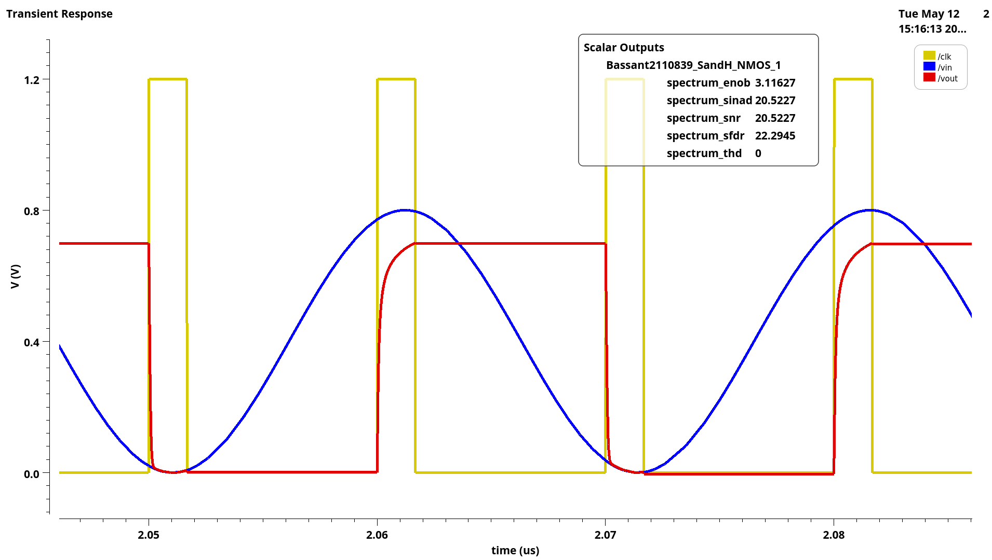
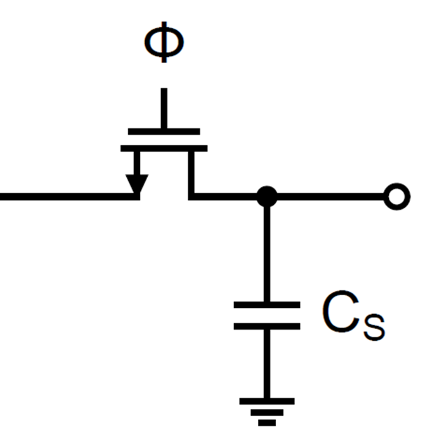
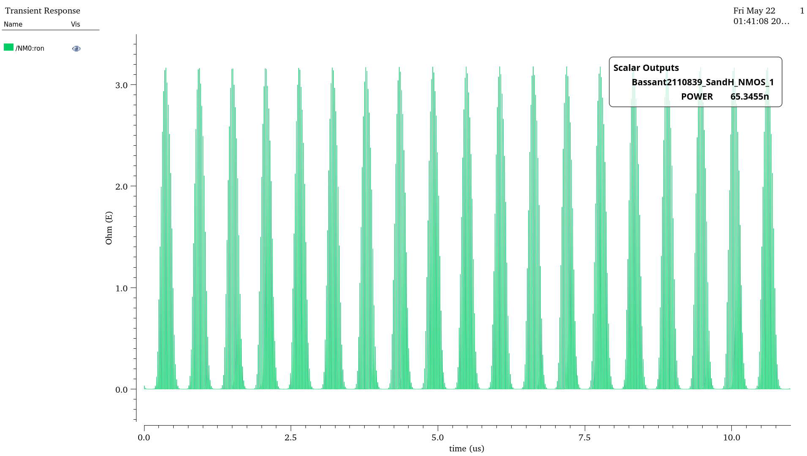
NMOS Track and Hold Transient Analysis
Vin
Vout
PARAMETER | SPEC | ACHIEVED
ENOB | =10 bits | 3bits
POWER | <5uwatt | 65.35nwatt

Slide 7
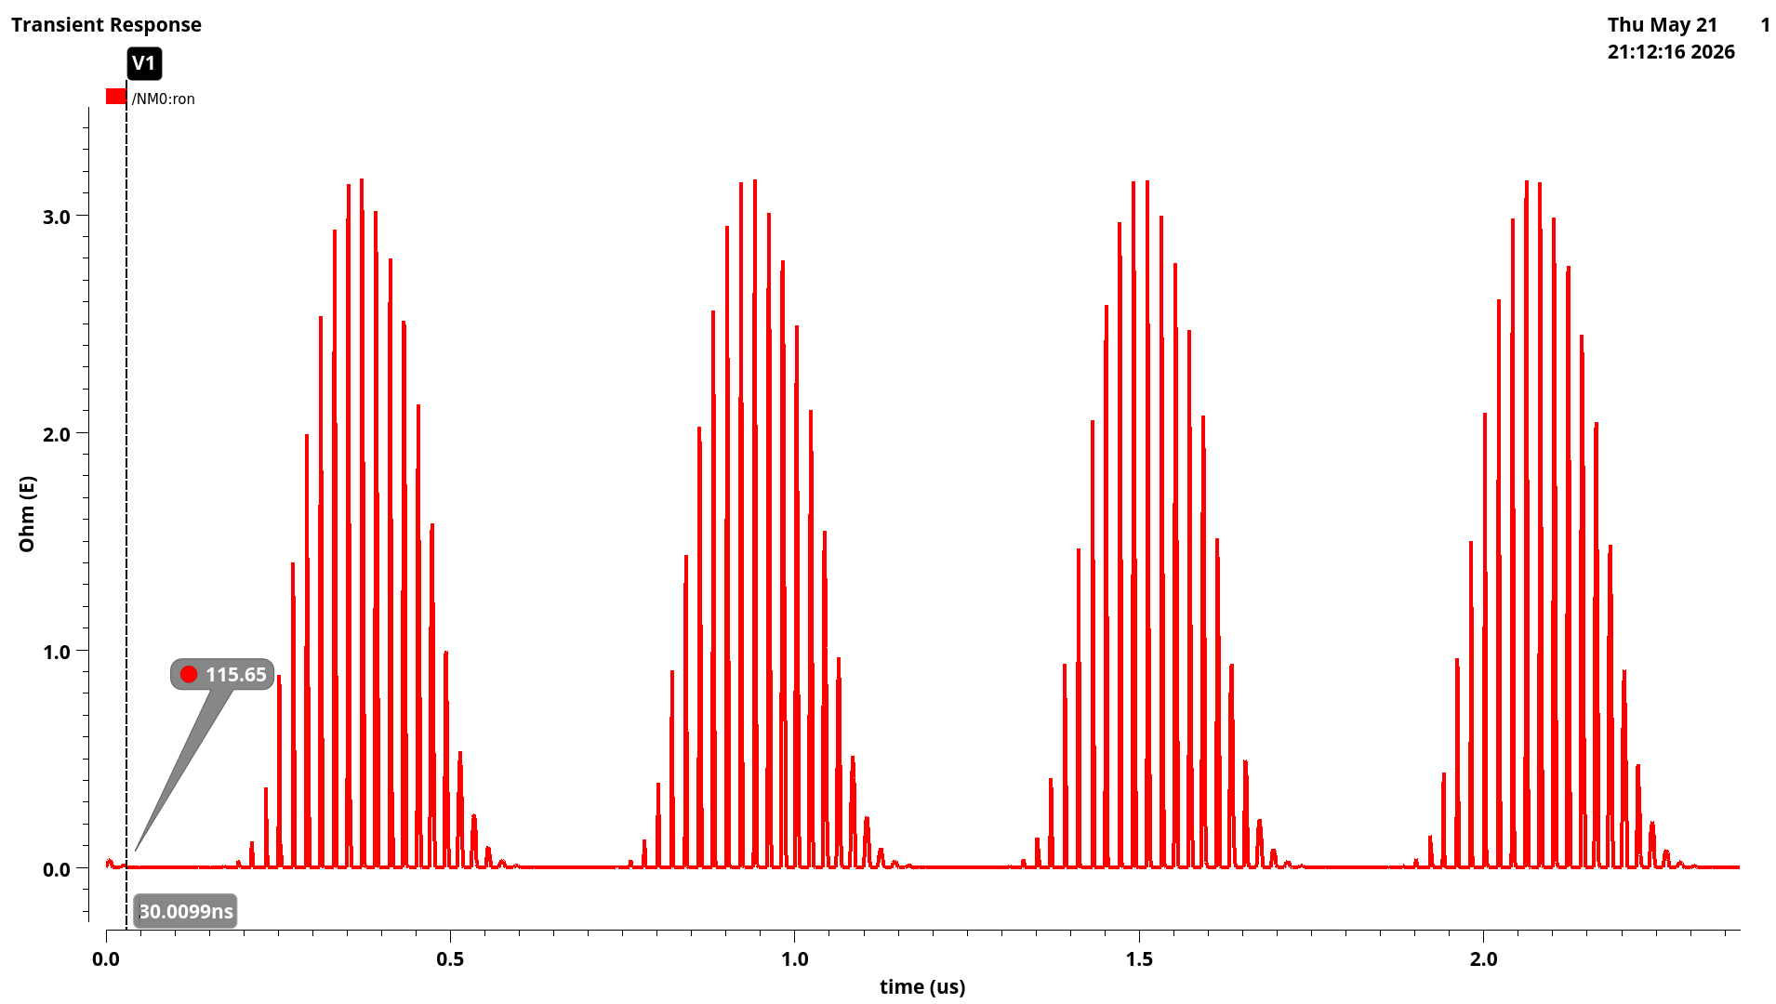
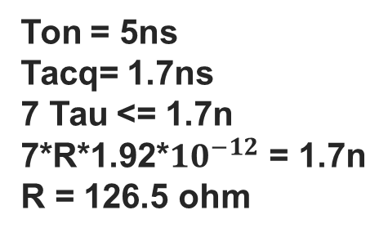
Ron of NMOS Track and Hold Transient Analysis
OFF
Vin
Vout
Ton = 5ns
Tacq= 1.7ns
7 Tau <= 1.7n
7*R*1.92*${10}^{−12}$ = 1.7n
R = 126.5 ohm
ON

Slide 8
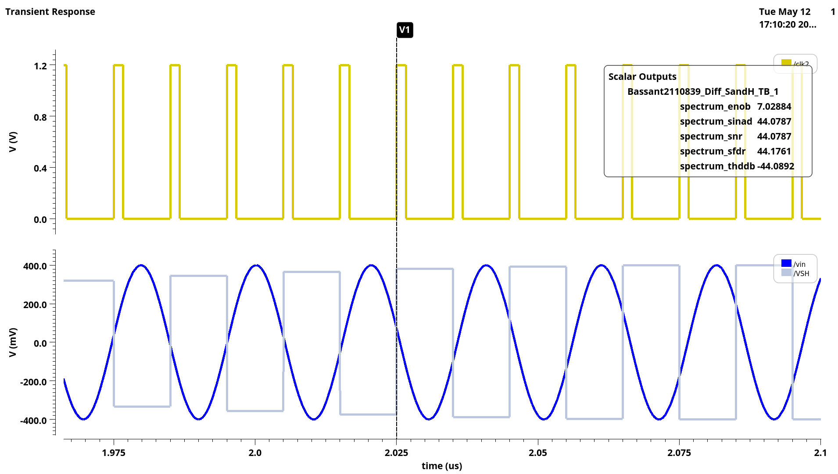
NMOS Differential Sample and Hold Transient Analysis
PARAMETER | SPEC | ACHIEVED
ENOB | =10 bits | 7bits

Slide 9
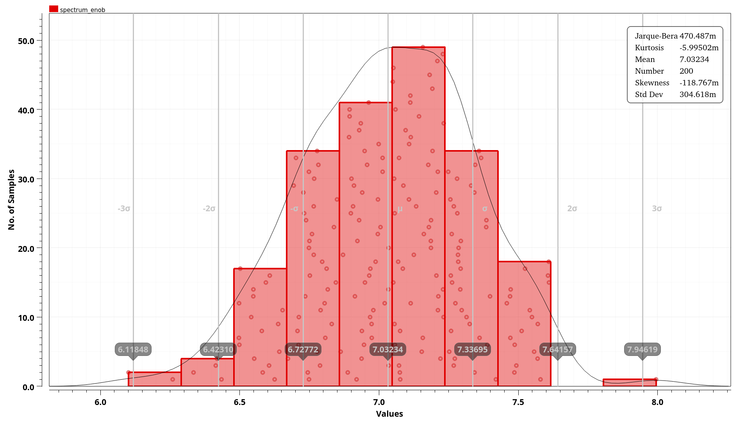
Monte Carlo simulation for ENOB

Slide 10
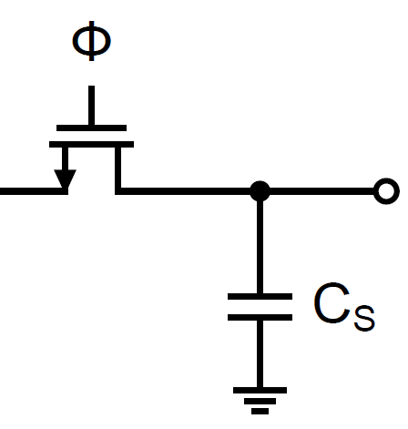
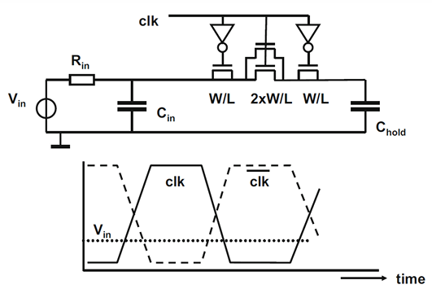
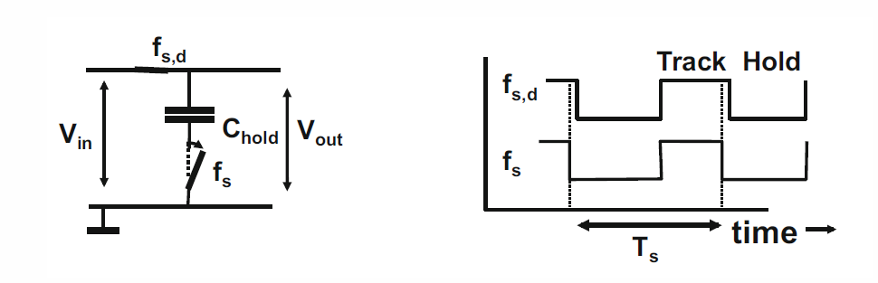
Bootstrapped Switch (non-idealities) and its solutions
V
CLK
0
R
ON
C
GD
Vin
Vout
Vin
Vout

Slide 11
Architecture of SAR ADC with Low Dropout Regulator
V
IN
Sample
-And-Hold
synchronous SAR Logic
D
OUT
Comparator
N-bit
DAC

Slide 12
Technology: 45 nm CMOS
Power Supply: 1.2v
Load Capacitor : 50fF
Delay < 500p
Power Consumption < 3mw
offset < 5m

Slide 13
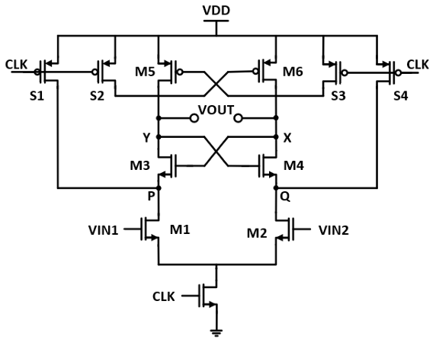
Comparator Structure Overview
Strong-arm Comparator
This architecture consists of :
Preamplifier M1andM2
Latch consist of two cross coupled inverters M3 : M6
reset switches to prevent hysteresis S1 : S4
It has two phases of operations :
Precharge phase when CLK=0
Amplification phase when CLK=1.
In Precharge phase (CLK=0):
the reset switches will be ON and they will charge nodes (P, Q, X, Y) with VDD to prevent hysteresis.
P & Q charged through S1 , S4 and X , Y through S2 , S3.
In Amplification phase (clk=1):
input pair transistors will be ON and they begin to discharge node (P, Q) and the faster one is according to the differential input.
then M3 and M4 will be ON when one the node (P,Q) equal VDD−VTHP then nodes (X, Y) start to discharge and then the positive feedback (regeneration) will operate and helps one of the outputs to reach VDD and the other reach the GND.

Slide 14
Dynamic Comparator
outp
inp
+
+
+
+
–
outn
inn
–
–
–
Strong Arm Latch
Buffer
RS Latch

Slide 15
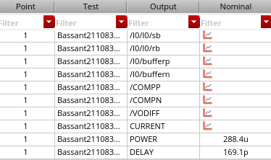
Transient Analyses Values
PARAMETER | SPEC | ACHIEVED
POWER | < 3mw | 288.4uw
DELAY | < 500ps | 169.1ps

Slide 16
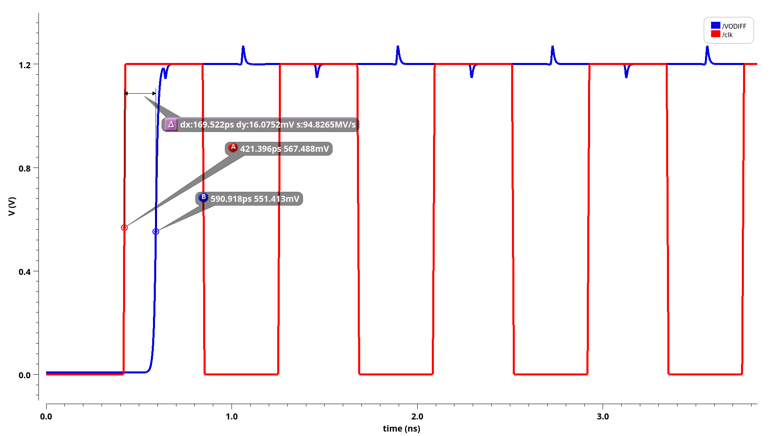
Delay of the comparator

Slide 17
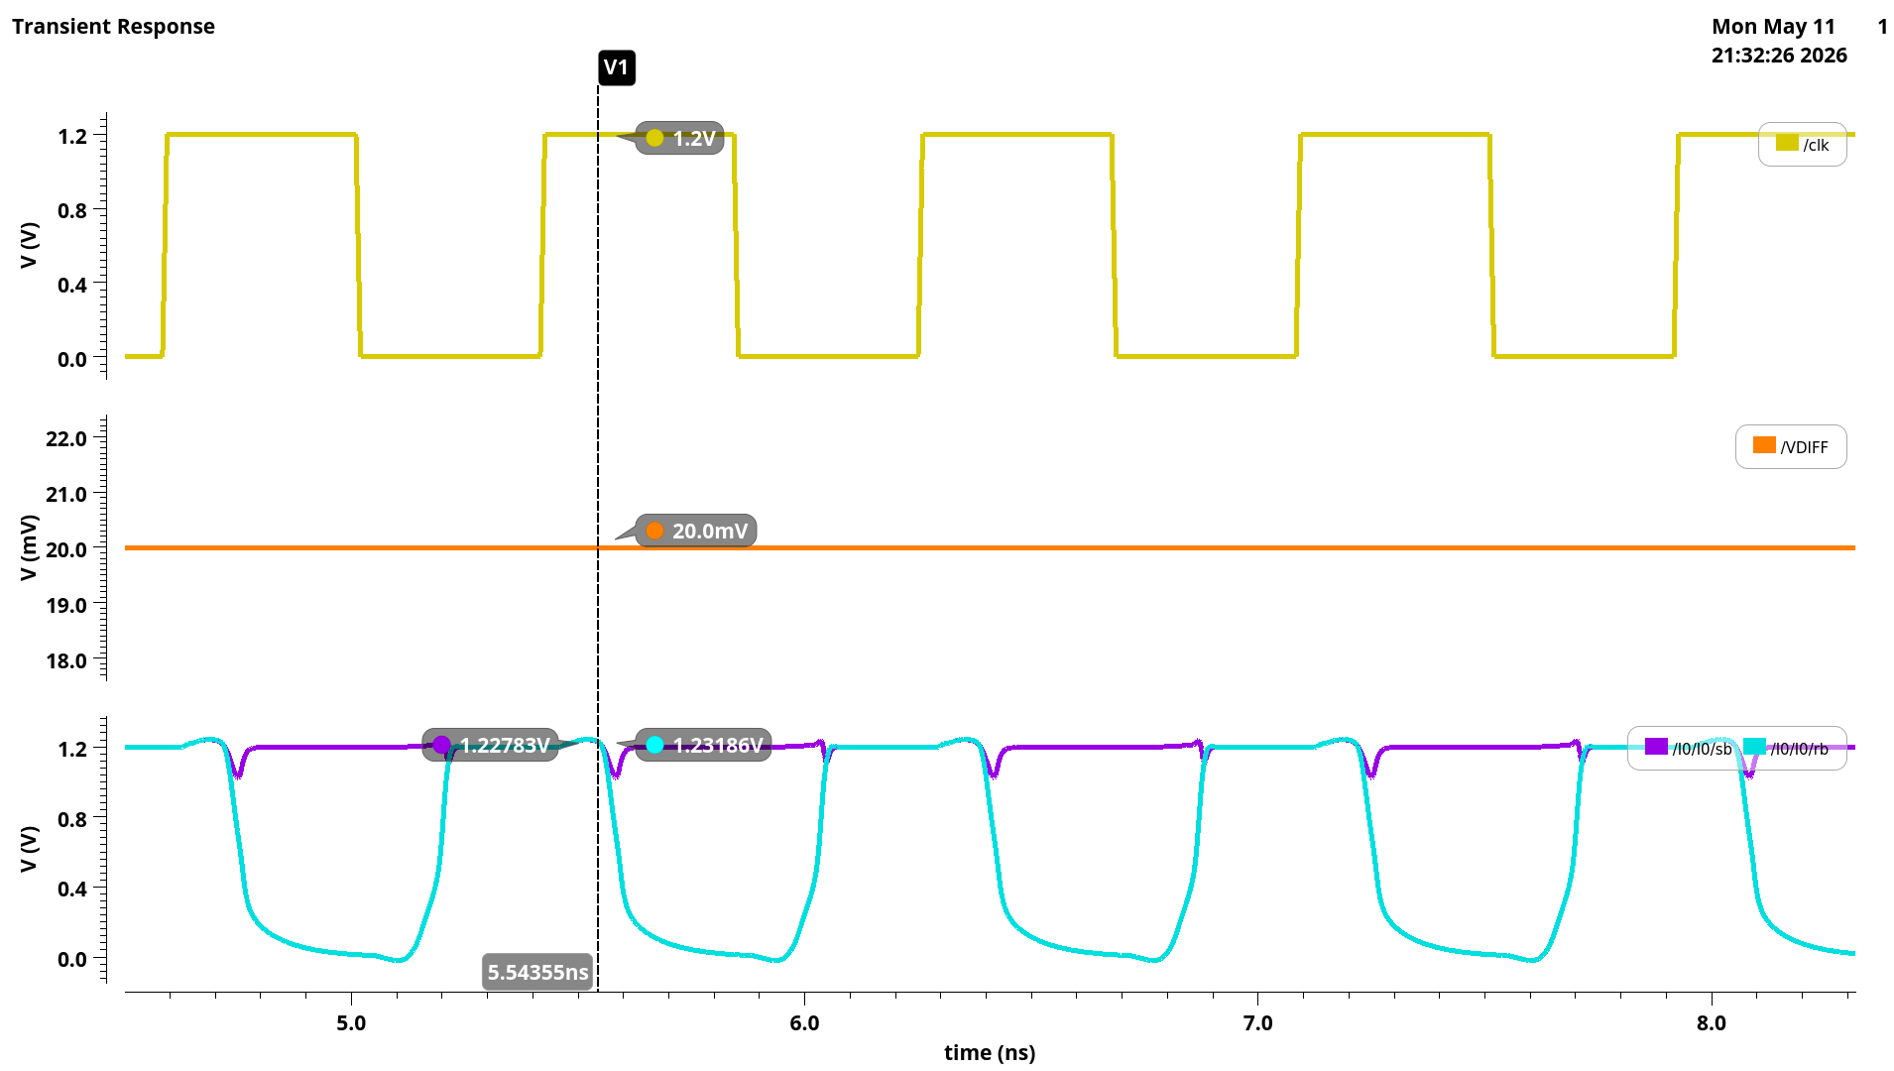
Transient Analysis for Strong-Arm Comparator

Slide 18
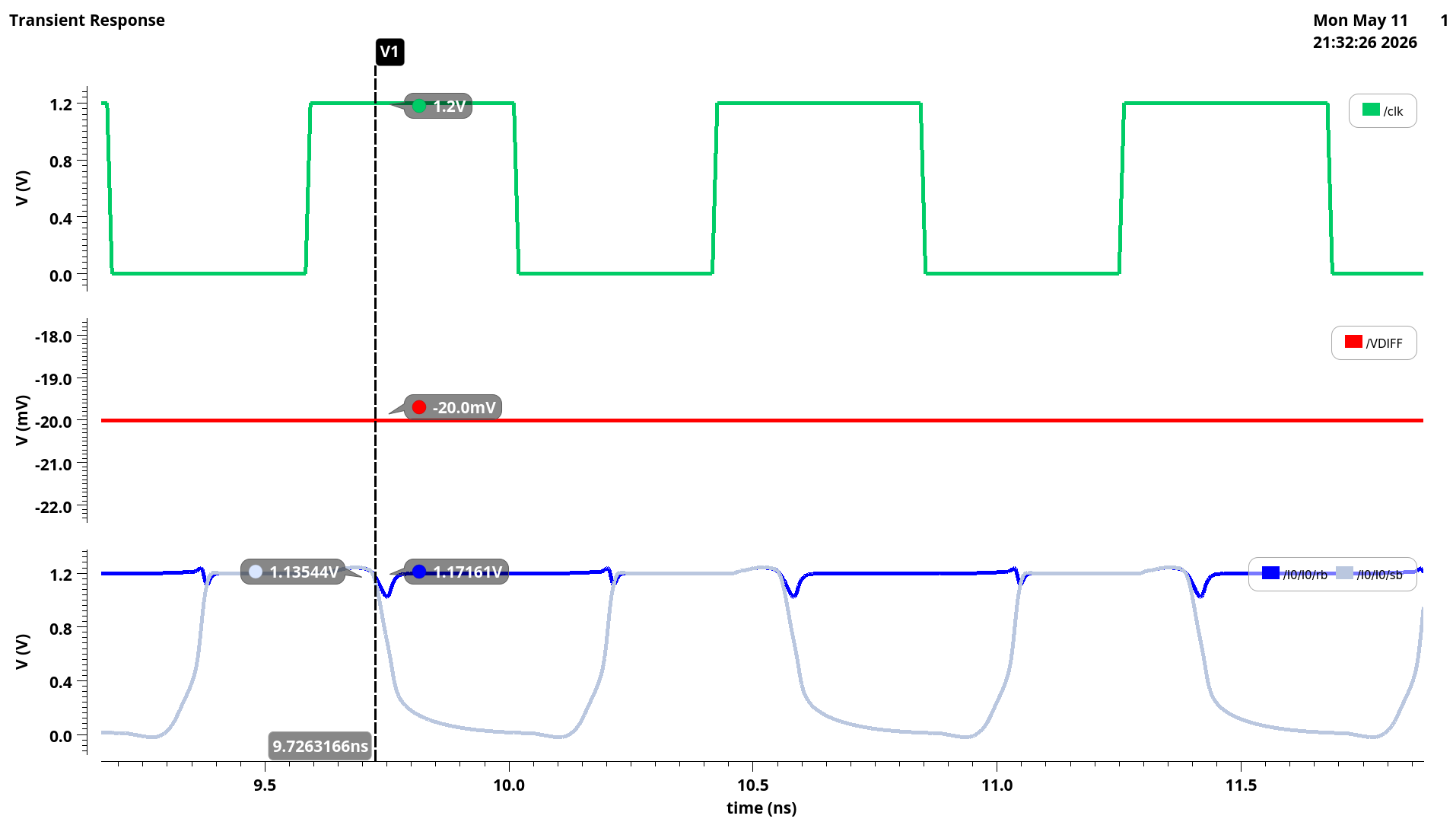
Transient Analysis for Strong-Arm Comparator

Slide 19
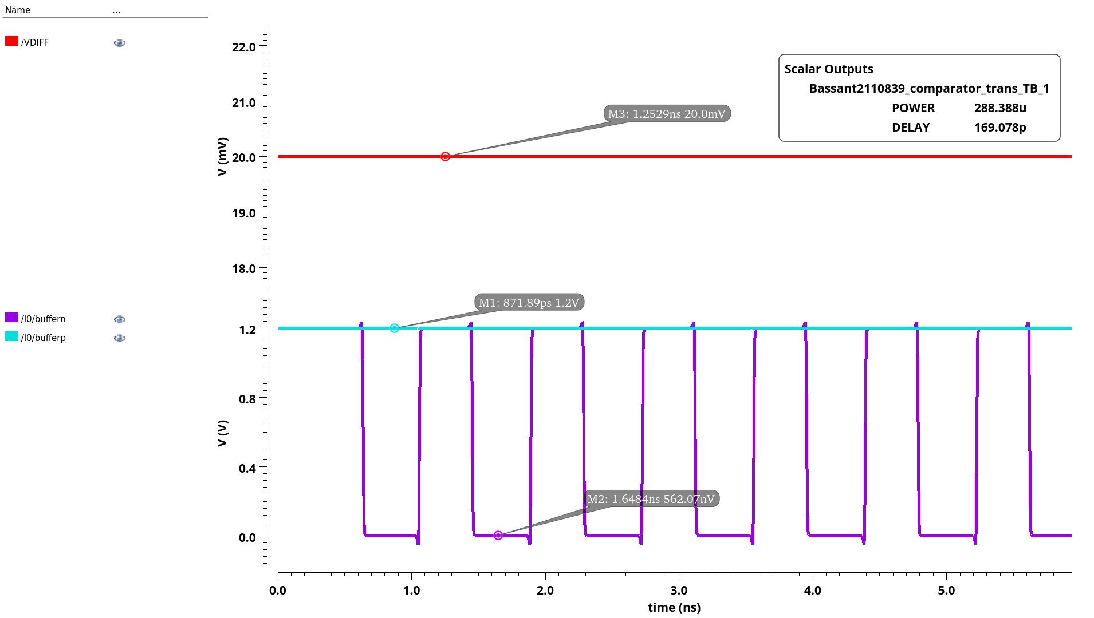
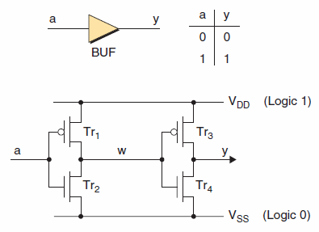
Transient Analysis for Strong-Arm Comparator with Buffer

Slide 20
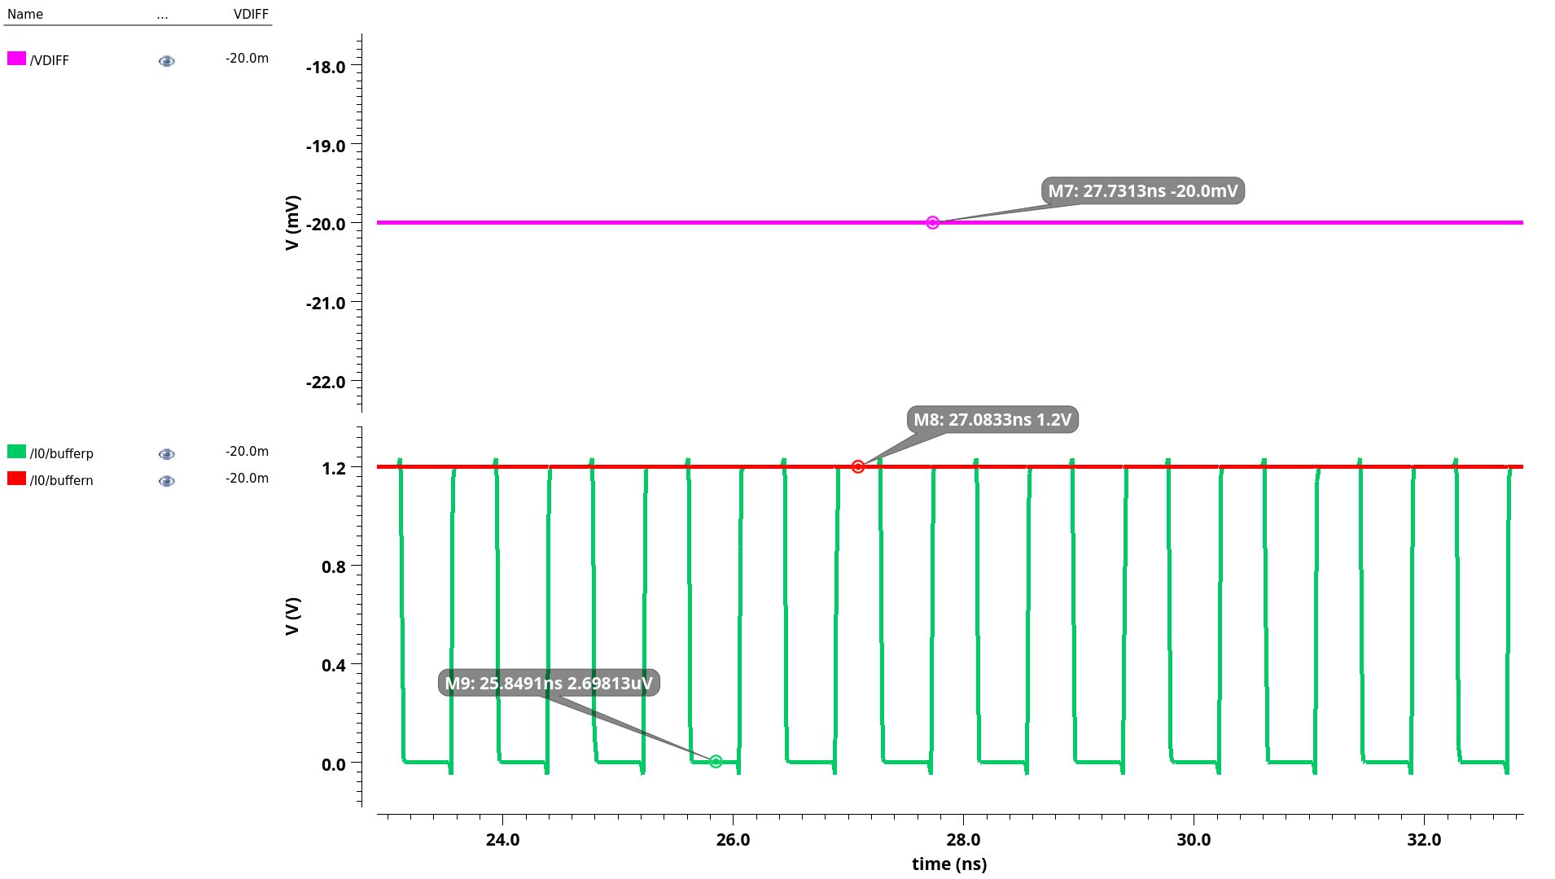
Transient Analysis for Strong-Arm Comparator with Buffer

Slide 21
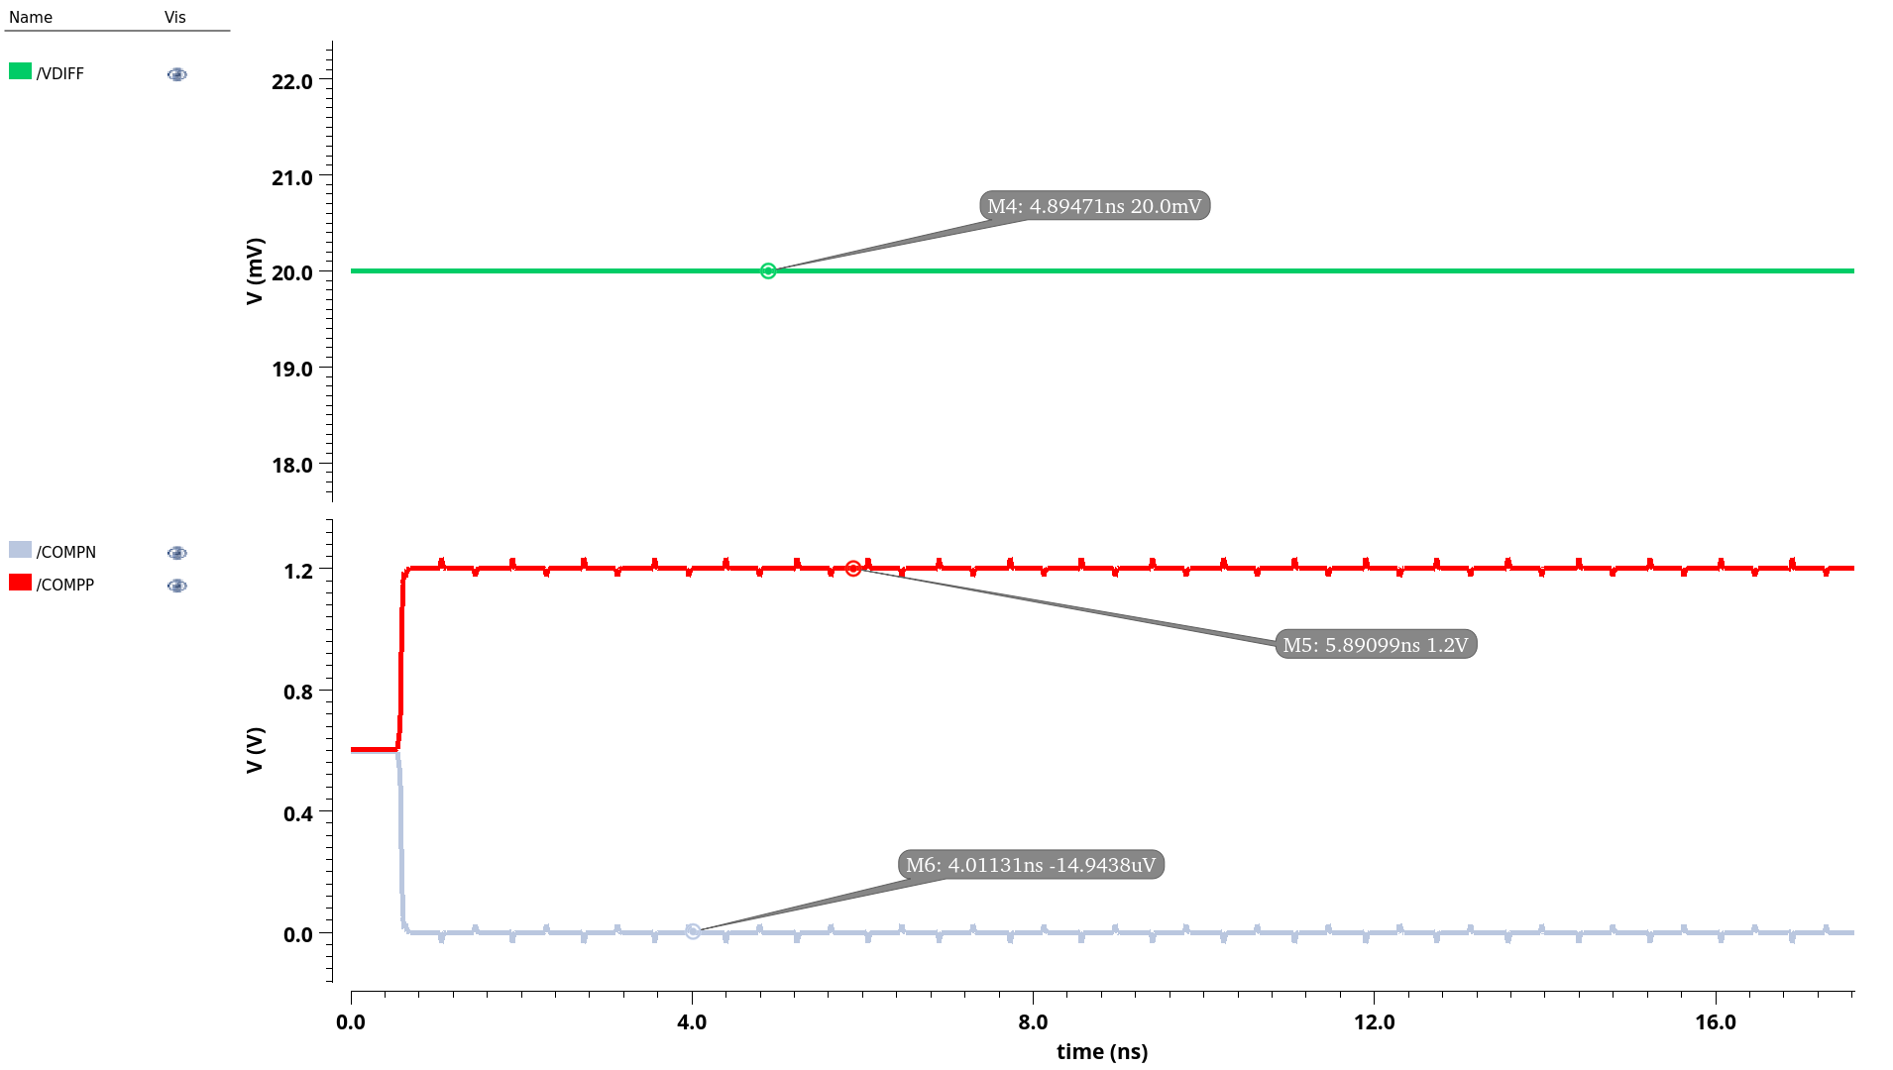
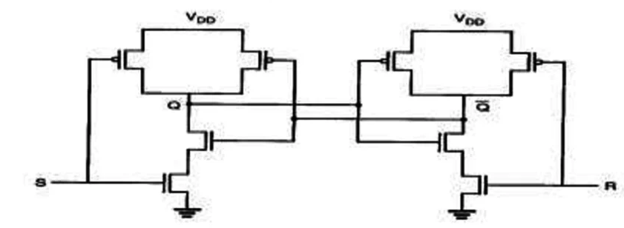
Transient Analysis for Strong-Arm Comparator with Buffer and SR-Latch

Slide 22
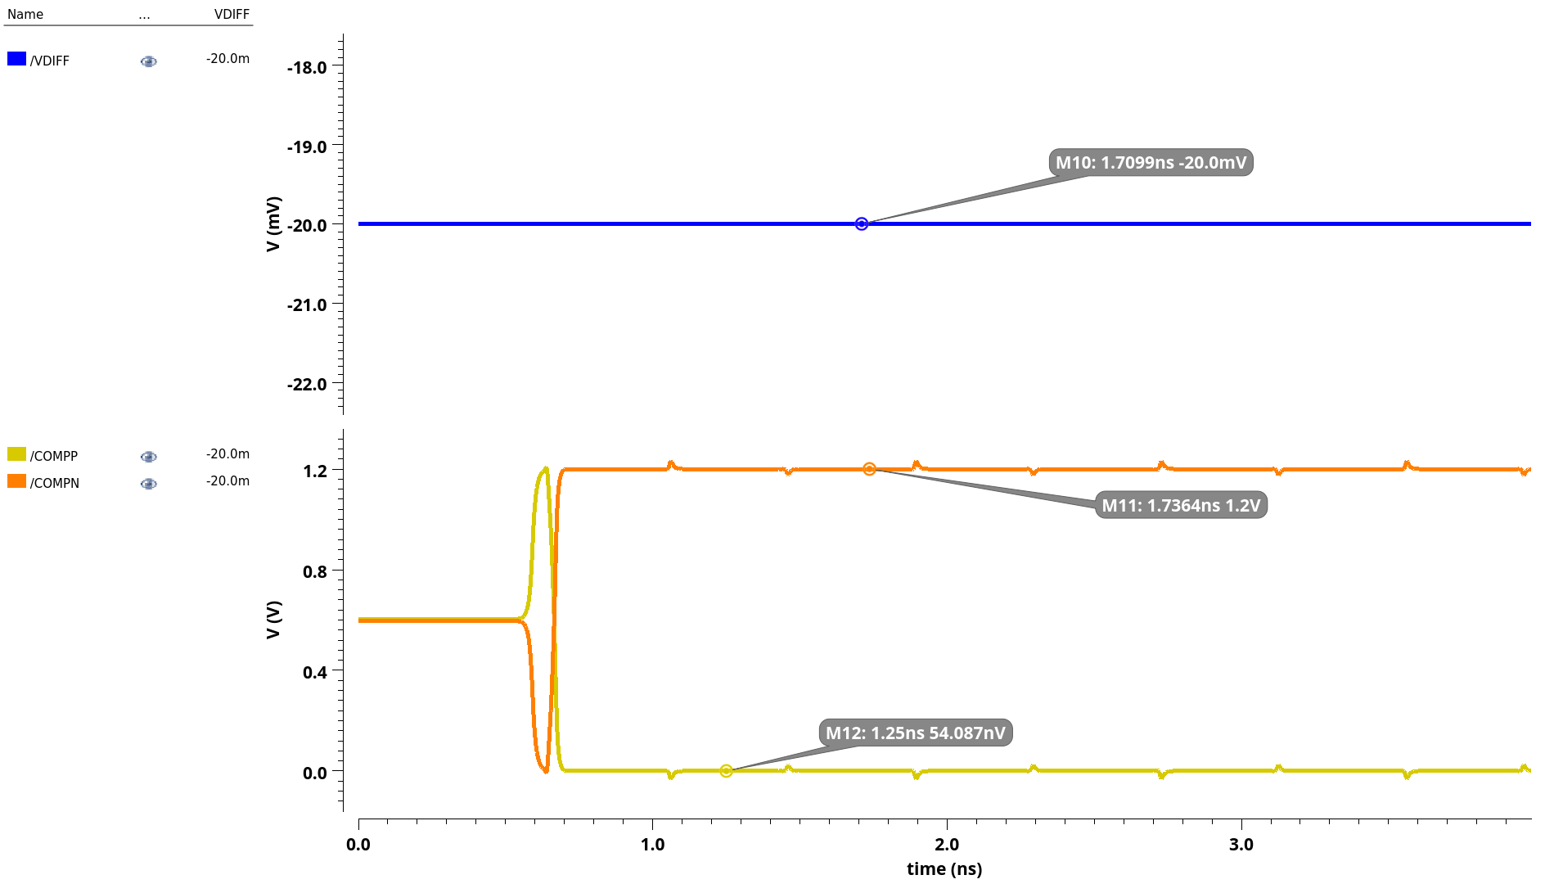
Transient Analysis for Strong-Arm Comparator with Buffer and SR-Latch

Slide 23
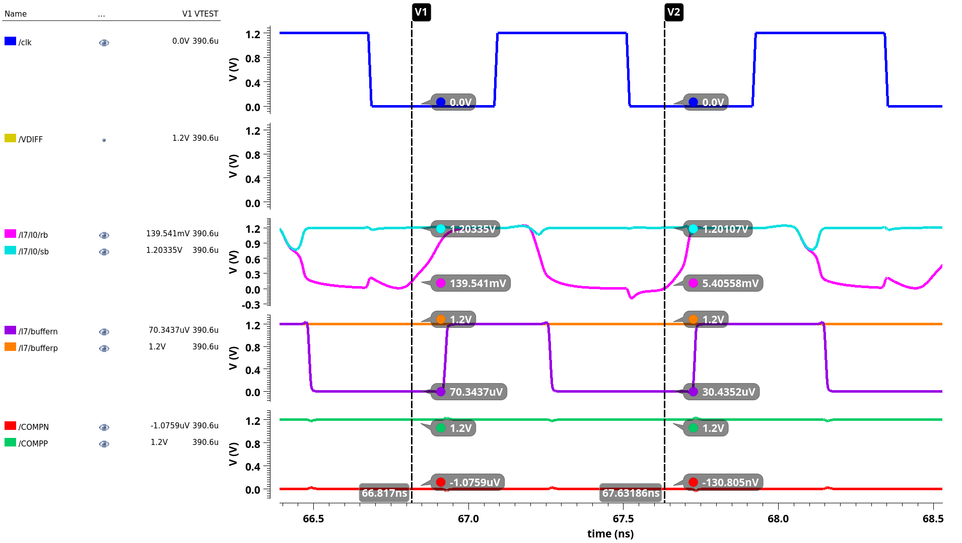
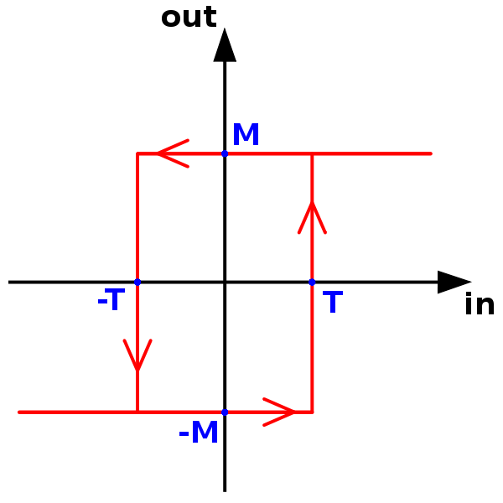
Overdrive Test for Full Comparator

Slide 24
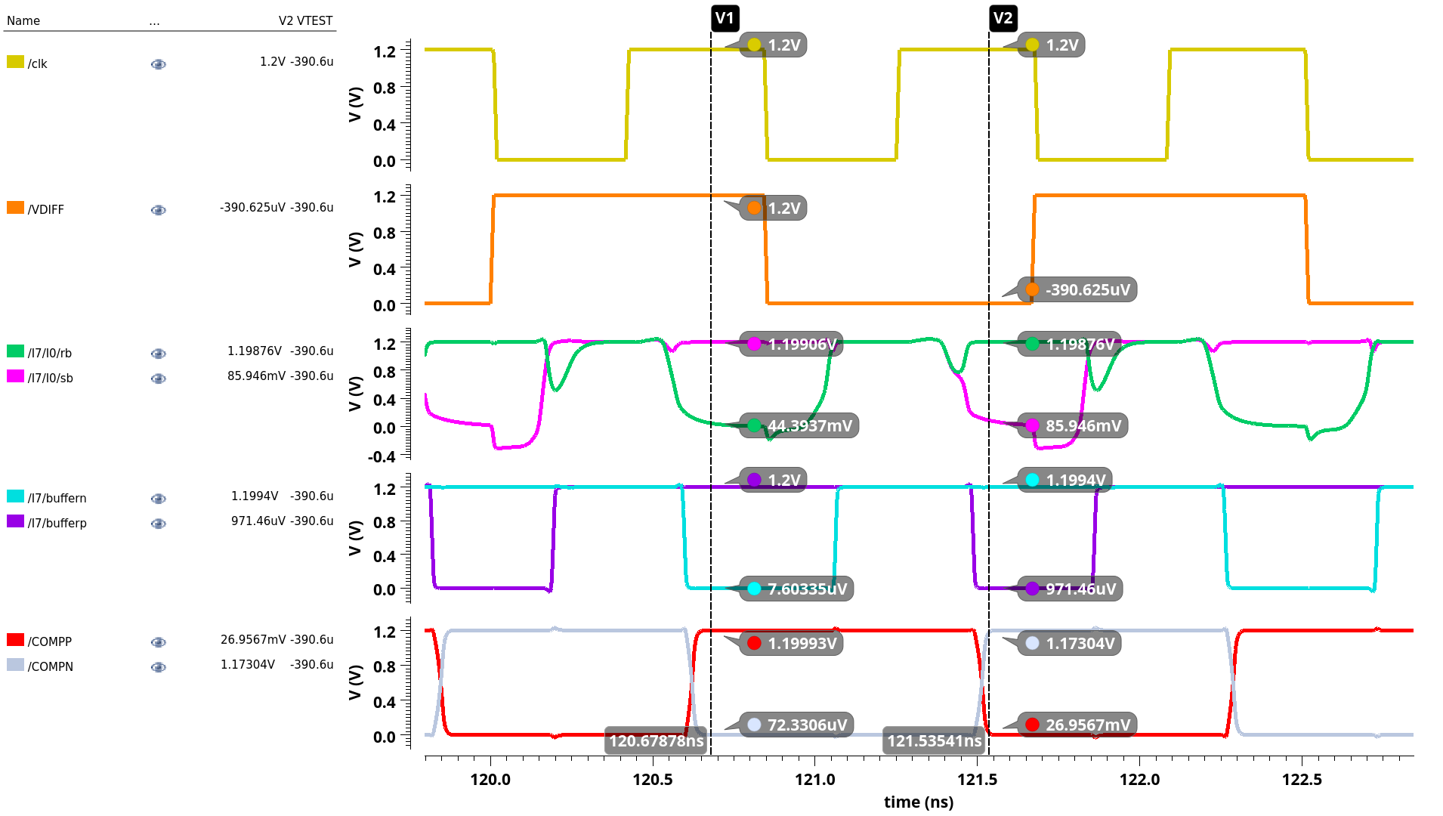
Overdrive Test for Full Comparator

Slide 25
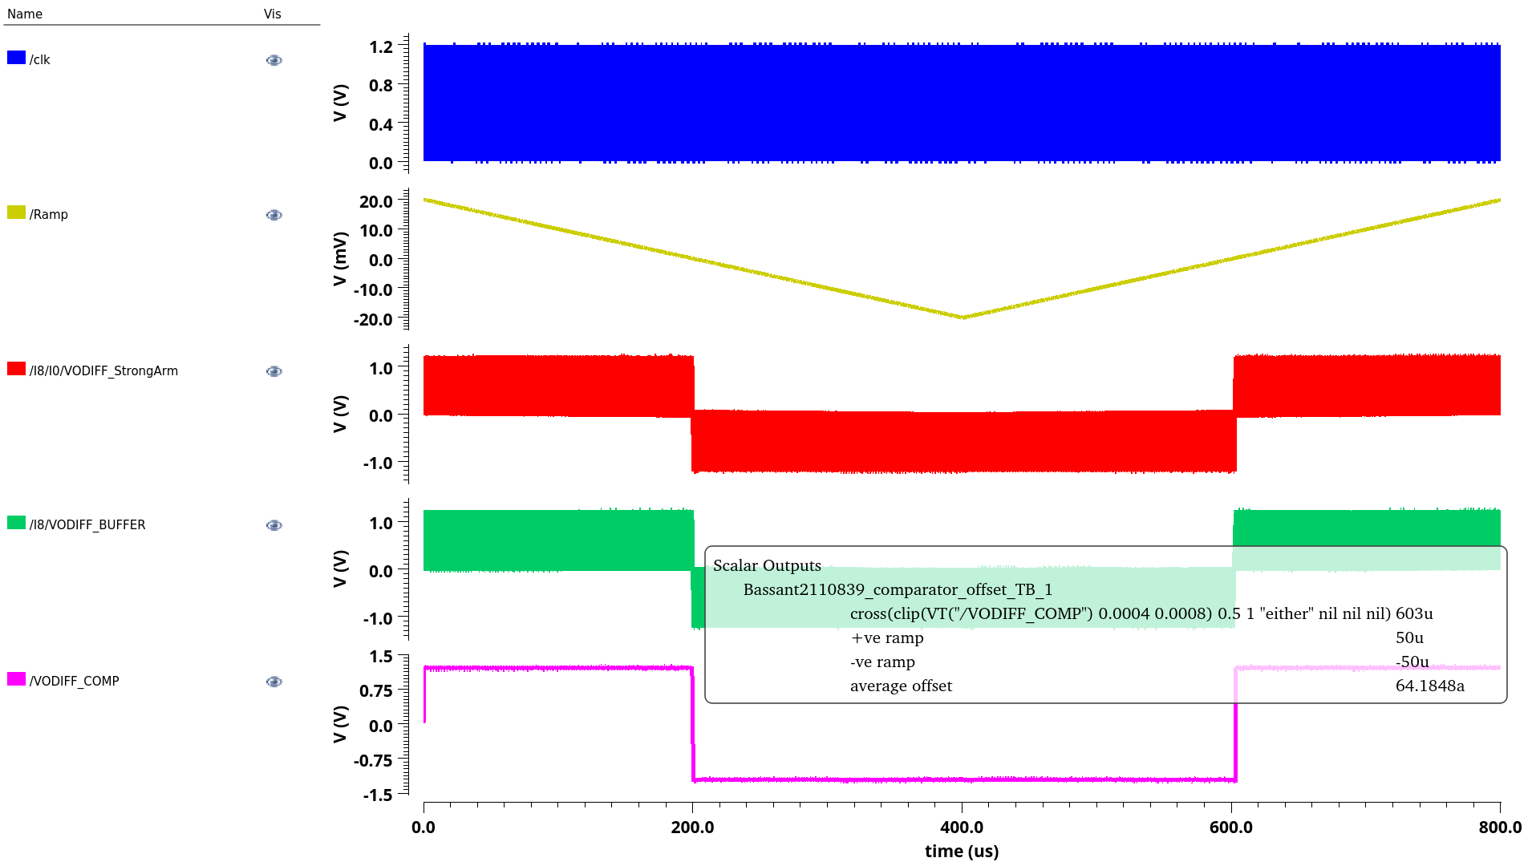
Offset Output For The Comparator
PARAMETER | SPEC | ACHIEVED
OFFSET | < 5mv | 64.18a

Slide 26
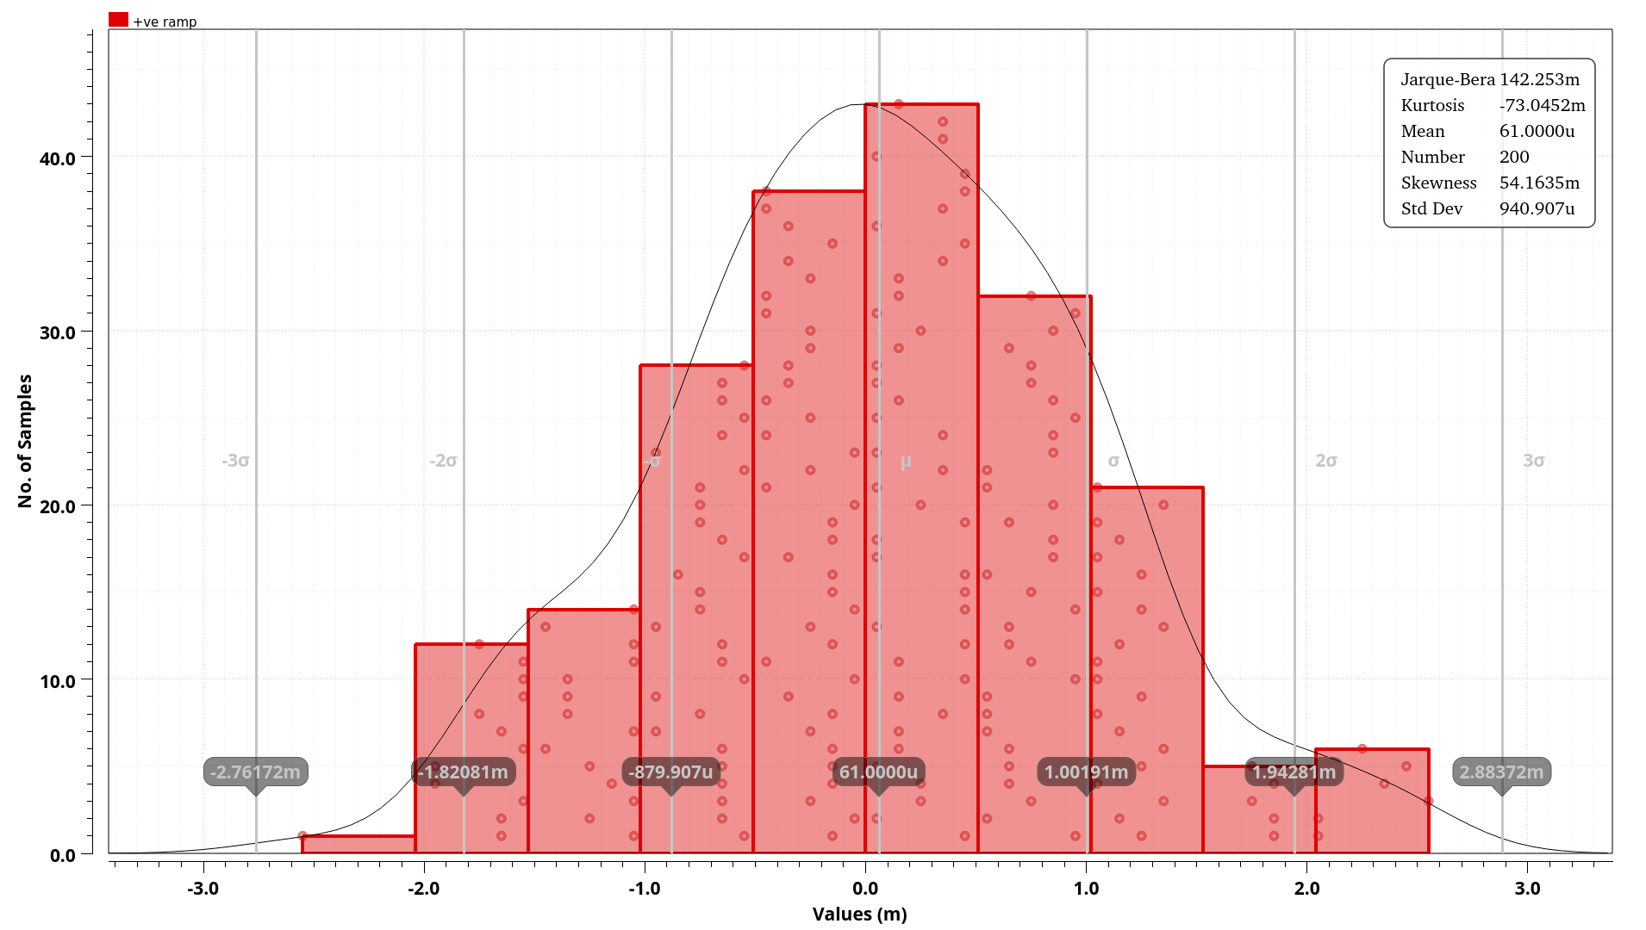
Monte Carlo simulation for Offset for +ve ramp

Slide 27

Monte Carlo simulation for Offset for -ve ramp

Slide 28
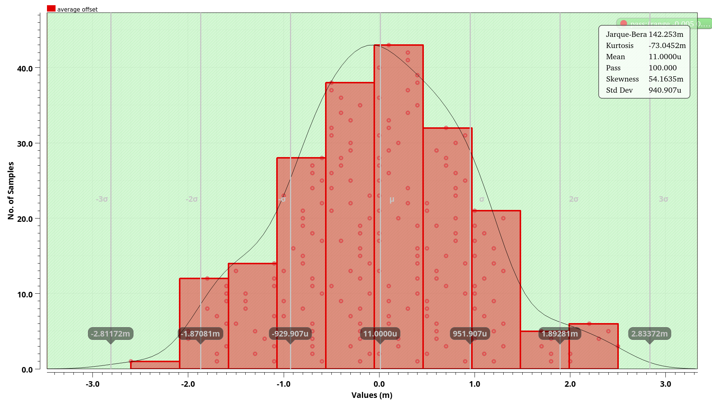
Monte Carlo simulation for Offset for +ve and -ve ramp

Slide 29
Architecture of SAR ADC with Low Dropout Regulator
V
IN
Sample
-And-Hold
synchronous SAR Logic
D
OUT
Comparator
N-bit
DAC

Slide 30
Technology: 45 nm CMOS
Power Supply: 1.2v
Delay < 200ps
Tr = Tf = 10ps
Power < 20 uwatt

Slide 31
Flow of SAR Logic
 |  | Sequencer Register Outputs |  |  |  |  |  |  |  |  |  |  |  |  |  |  | Code Register Outputs |  |  |  |  |  |  |  |  | Comparator Output
 |  | DFF_init | DFF9 | DFF8 | DFF7 | DFF6 | DFF5 | DFF4 | DFF3 | DFF2 | DFF1 | DFF0 | DFF_end |  | DFFc9 | DFFc8 | DFFc7 | DFFc6 | DFFc5 | DFFc4 | DFFc3 | DFFc2 | DFFc1 | DFFc0 | DFFc_end | Comp_out
0 | Sampling | 1 | 0 | 0 | 0 | 0 | 0 | 0 | 0 | 0 | 0 | 0 | 0 |  | 0 | 0 | 0 | 0 | 0 | 0 | 0 | 0 | 0 | 0 | 0 | X
1 | Comparison 1 | 0 | 1 | 0 | 0 | 0 | 0 | 0 | 0 | 0 | 0 | 0 | 0 |  | 1 | 0 | 0 | 0 | 0 | 0 | 0 | 0 | 0 | 0 | 0 | B9
2 | Comparison 2 | 0 | 0 | 1 | 0 | 0 | 0 | 0 | 0 | 0 | 0 | 0 | 0 |  | B9 | 1 | 0 | 0 | 0 | 0 | 0 | 0 | 0 | 0 | 0 | B8
3 | Comparison 3 | 0 | 0 | 0 | 1 | 0 | 0 | 0 | 0 | 0 | 0 | 0 | 0 |  | B9 | B8 | 1 | 0 | 0 | 0 | 0 | 0 | 0 | 0 | 0 | B7
4 | Comparison 4 | 0 | 0 | 0 | 0 | 1 | 0 | 0 | 0 | 0 | 0 | 0 | 0 |  | B9 | B8 | B7 | 1 | 0 | 0 | 0 | 0 | 0 | 0 | 0 | B6
5 | Comparison 5 | 0 | 0 | 0 | 0 | 0 | 1 | 0 | 0 | 0 | 0 | 0 | 0 |  | B9 | B8 | B7 | B6 | 1 | 0 | 0 | 0 | 0 | 0 | 0 | B5
6 | Comparison 6 | 0 | 0 | 0 | 0 | 0 | 0 | 1 | 0 | 0 | 0 | 0 | 0 |  | B9 | B8 | B7 | B6 | B5 | 1 | 0 | 0 | 0 | 0 | 0 | B4
7 | Comparison 7 | 0 | 0 | 0 | 0 | 0 | 0 | 0 | 1 | 0 | 0 | 0 | 0 |  | B9 | B8 | B7 | B6 | B5 | B4 | 1 | 0 | 0 | 0 | 0 | B3
8 | Comparison 8 | 0 | 0 | 0 | 0 | 0 | 0 | 0 | 0 | 1 | 0 | 0 | 0 |  | B9 | B8 | B7 | B6 | B5 | B4 | B3 | 1 | 0 | 0 | 0 | B2
9 | Comparison 9 | 0 | 0 | 0 | 0 | 0 | 0 | 0 | 0 | 0 | 1 | 0 | 0 |  | B9 | B8 | B7 | B6 | B5 | B4 | B3 | B2 | 1 | 0 | 0 | B1
10 | Comparison 10 | 0 | 0 | 0 | 0 | 0 | 0 | 0 | 0 | 0 | 0 | 1 | 0 |  | B9 | B8 | B7 | B6 | B5 | B4 | B3 | B2 | B1 | 1 | 0 | B0
11 | Final Output | 0 | 0 | 0 | 0 | 0 | 0 | 0 | 0 | 0 | 0 | 0 | 1 |  | B9 | B8 | B7 | B6 | B5 | B4 | B3 | B2 | B1 | B0 | 1 | X

Slide 32
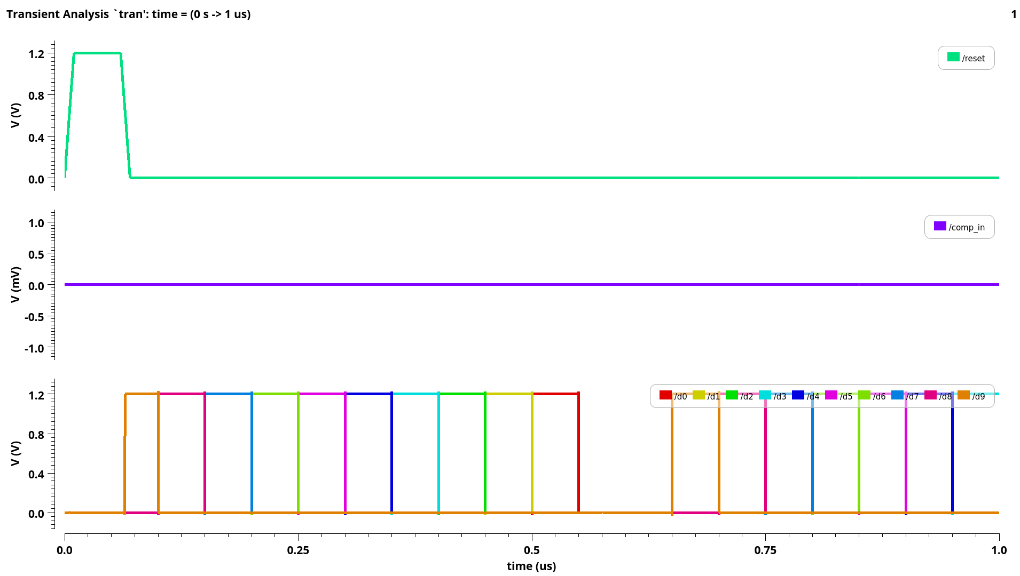
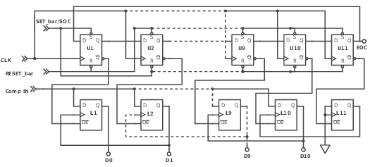
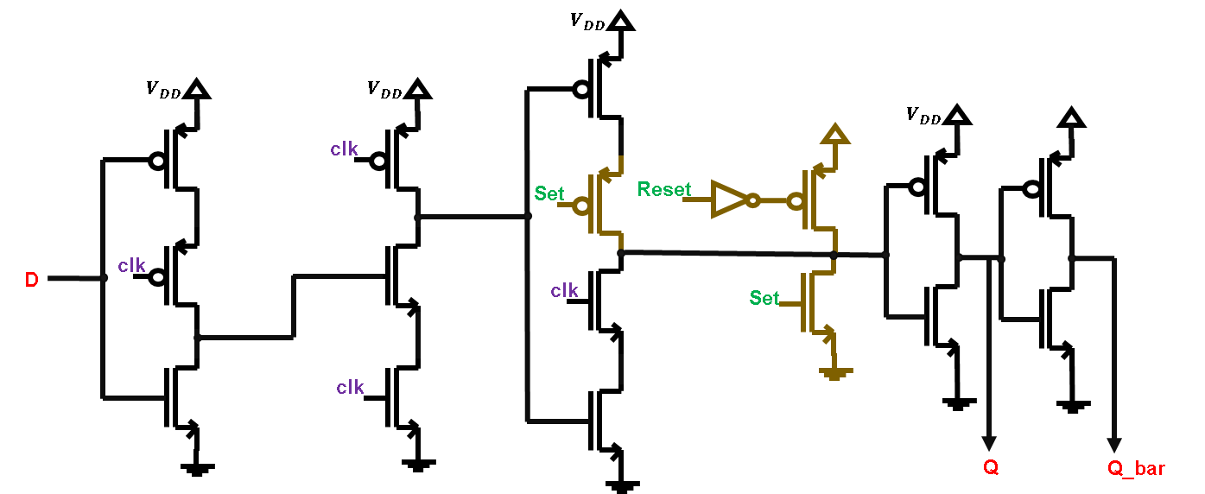
Output of SAR Logic when input comparator equals to zero

Slide 33
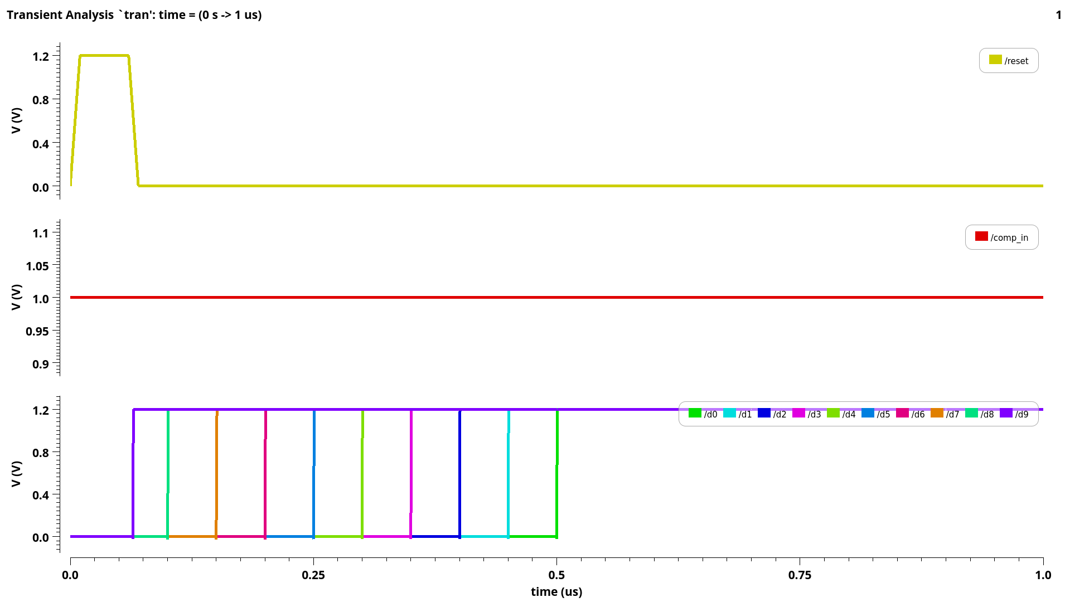
Output of SAR Logic when input comparator equals to one

Slide 34
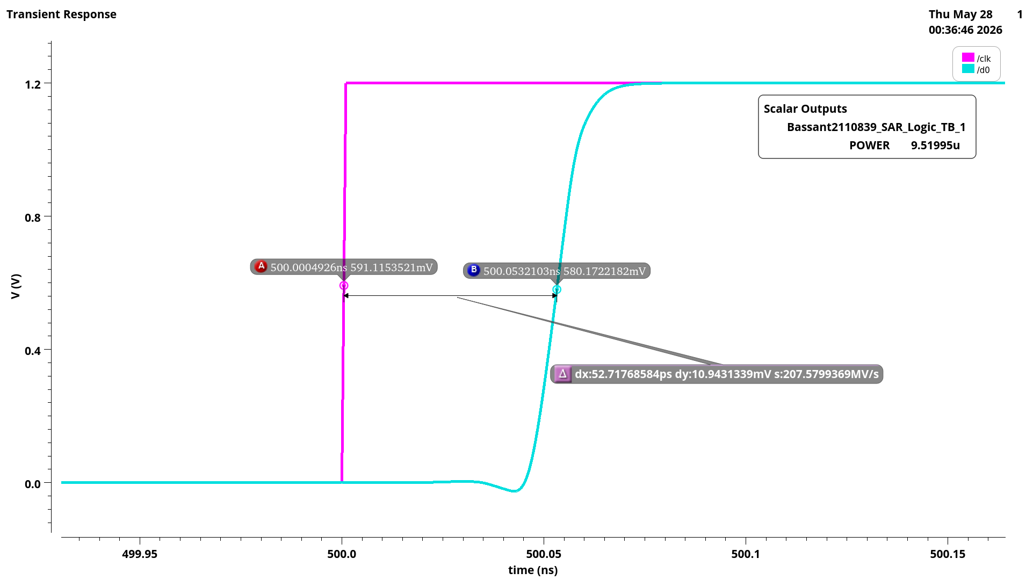
Delay and Power of SAR Logic
PARAMETER | SPEC | ACHIEVED
DELAY | < 200ps | 52.7ps
POWER | < 20uw | 9.5uwatt

Slide 35
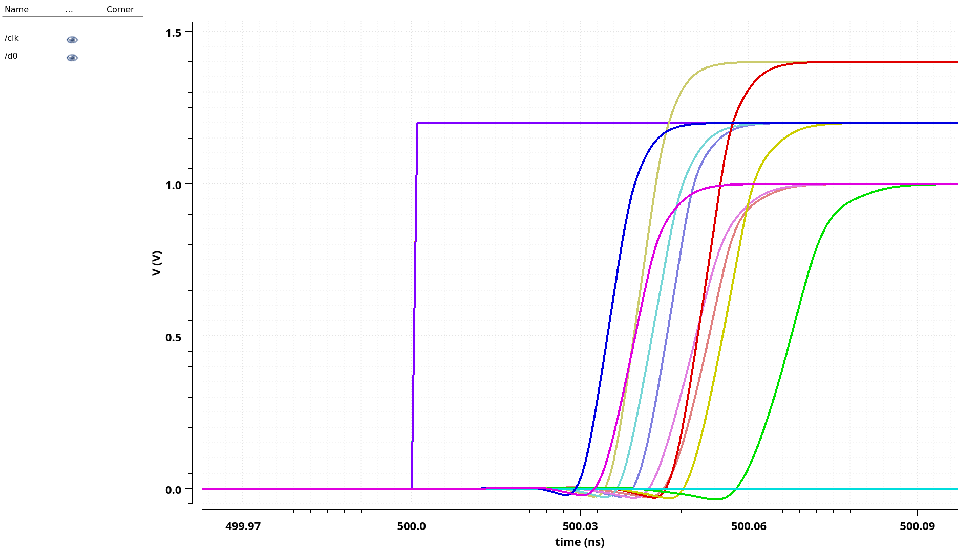
SAR Logic corners with temperature -30 °K, supply voltage 1, 1.2, 1.4 V

Slide 36
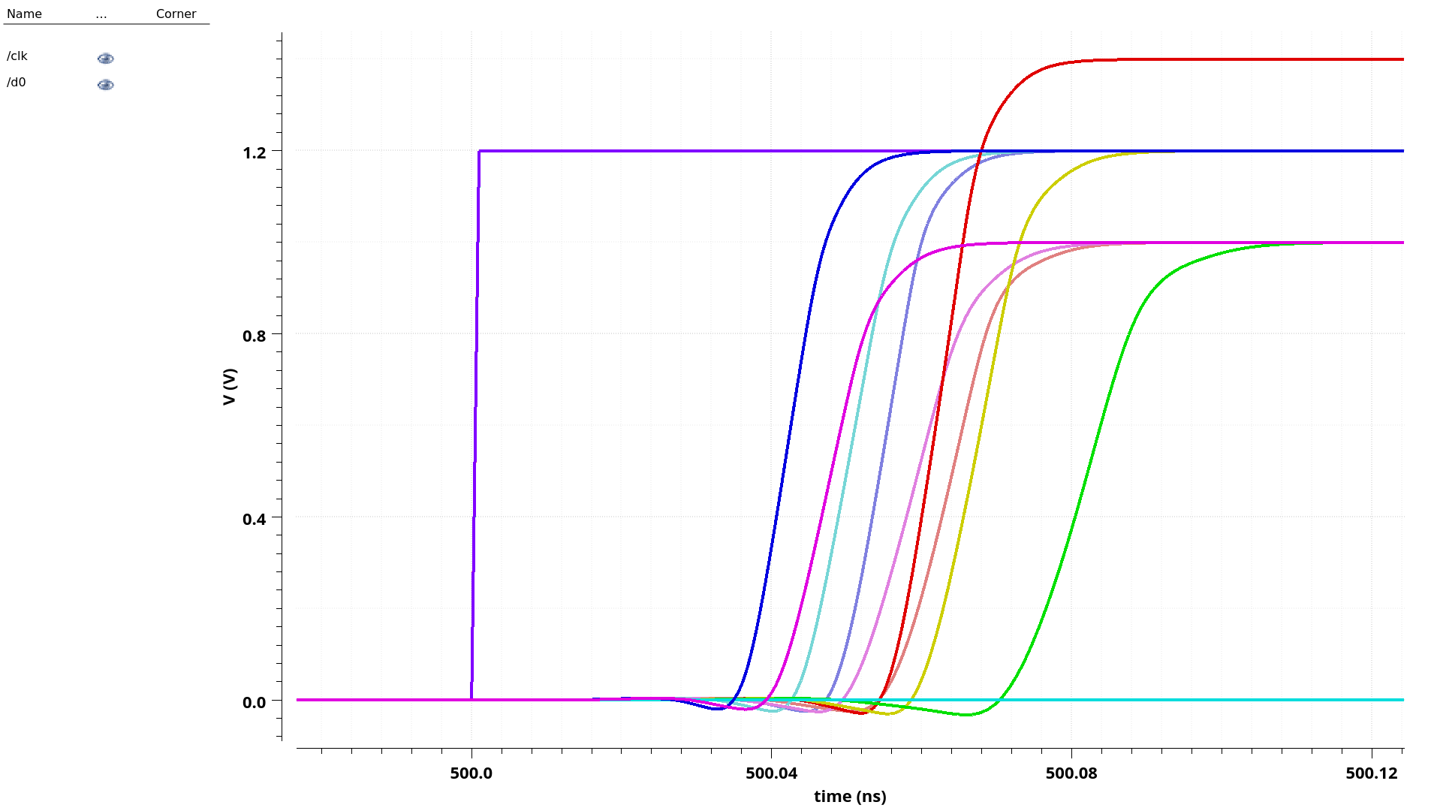
SAR Logic corners with temperature 27 °K, supply voltage 1, 1.2, 1.4 V

Slide 37
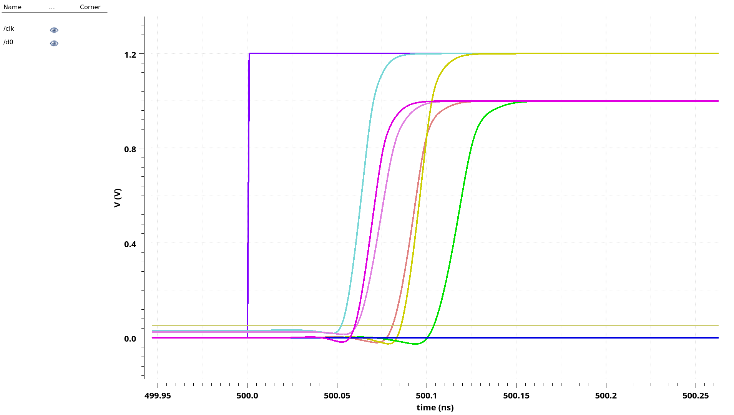
SAR Logic corners with temperature 150 °K, supply voltage 1, 1.2, 1.4 V

Slide 38
Architecture of SAR ADC with Low Dropout Regulator
V
IN
Sample
-And-Hold
synchronous SAR Logic
D
OUT
Comparator
N-bit
DAC

Slide 39
Technology: 45 nm CMOS
Power Supply: 1.2v
Capacitor : 15 fF
Power < 7 uwatt
INL = + 0.5 LSB, -0.5 LSB
DNL = + 0.5 LSB, -0.5 LSB

Slide 40
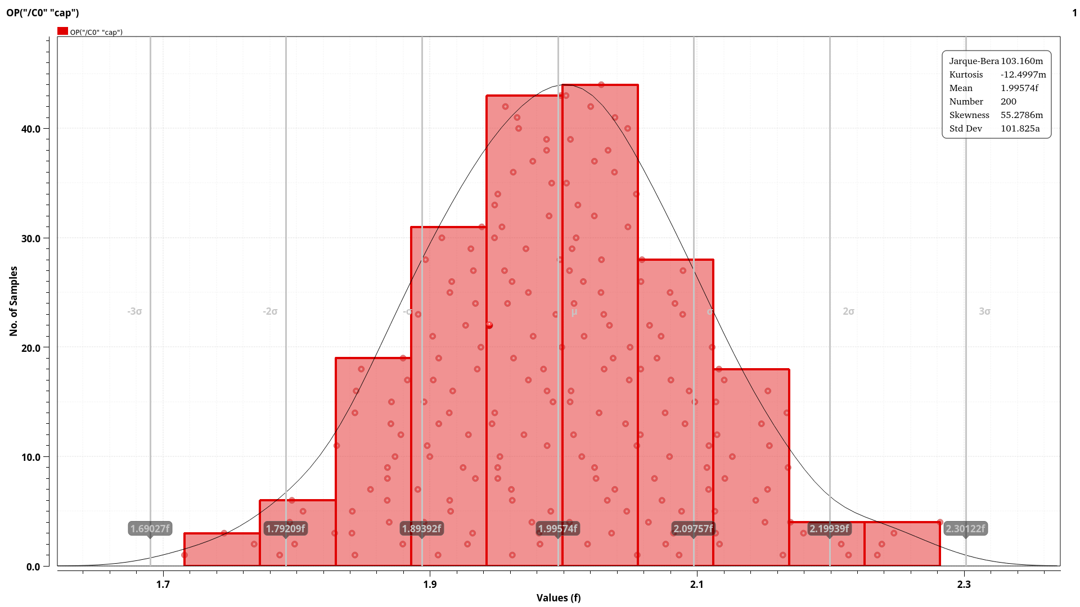
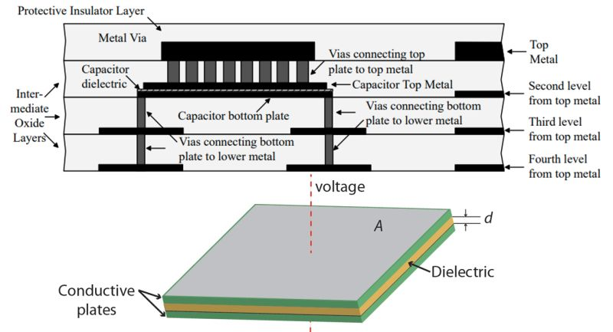
Monte Carlo Analysis for MIM Cap

Slide 41
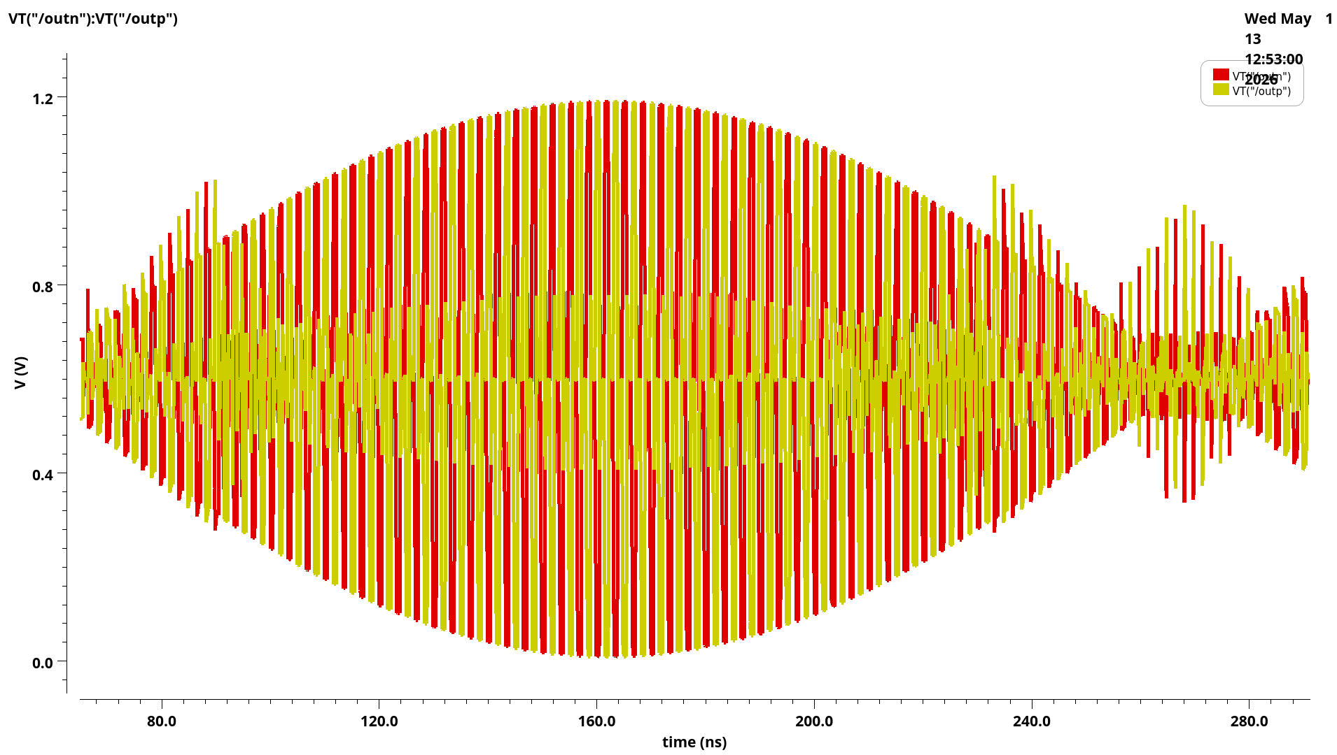
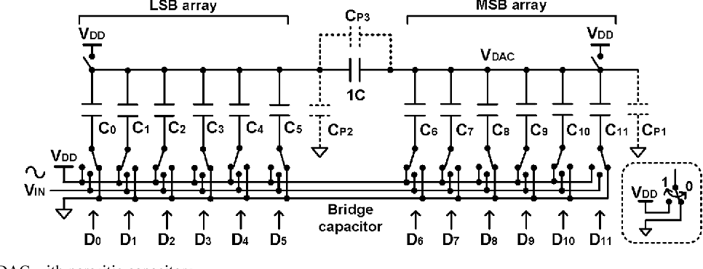
Output of C_Bridge DAC

Slide 42
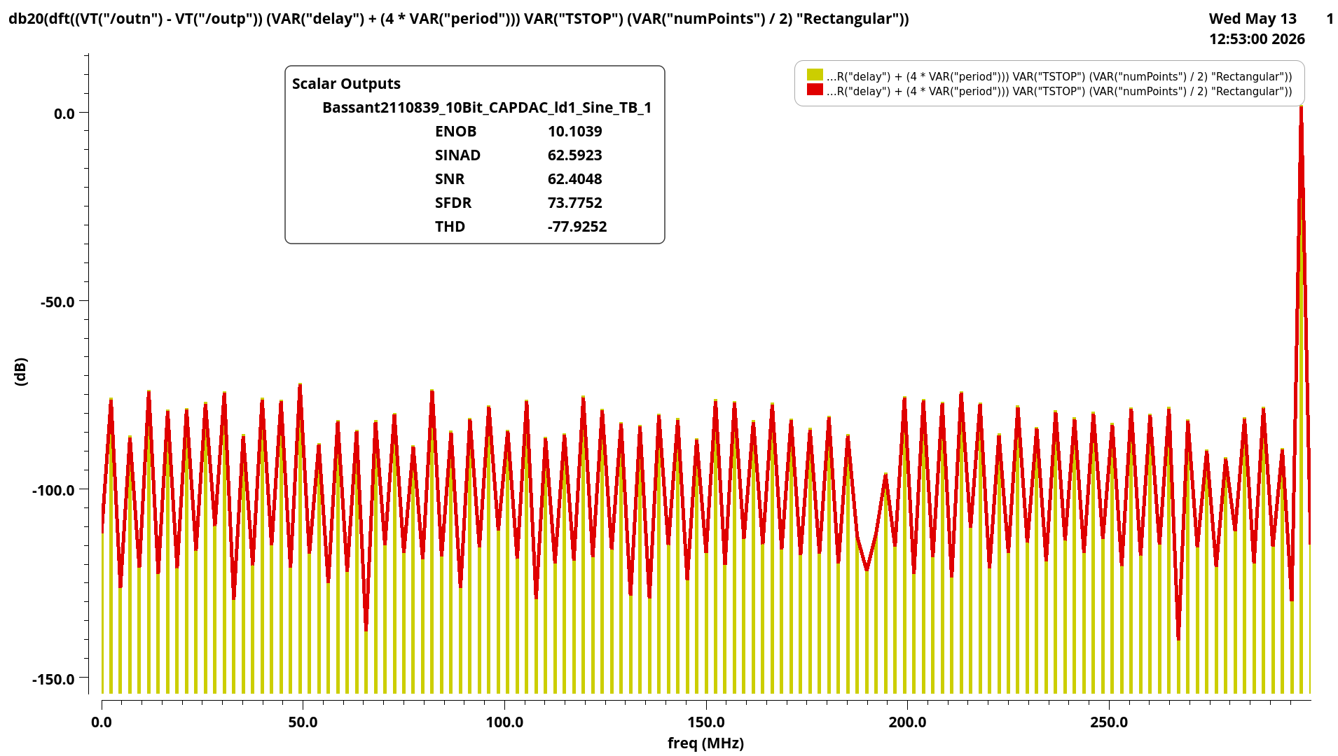
ENOB value for C_ Bridge DAC with ideal T&H
PARAMETER | SPEC | ACHIEVED
ENOB | 10 bits | 10 bits

Slide 43
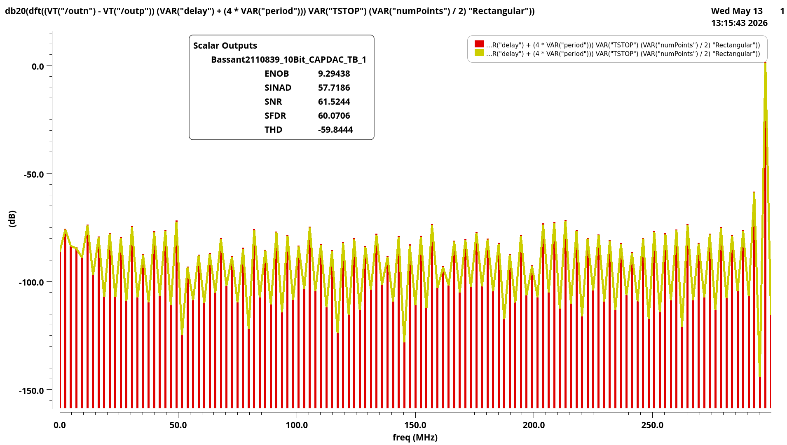
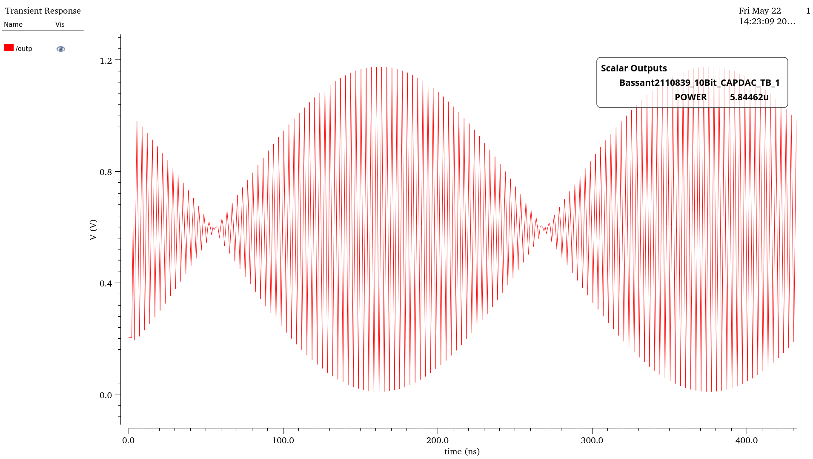
ENOB value for C_ Bridge DAC with Practical T&H
PARAMETER | SPEC | ACHIEVED
ENOB | 10 bits | 9.29 bits
POWER | < 7uwatt | 5.85uwatt

Slide 44

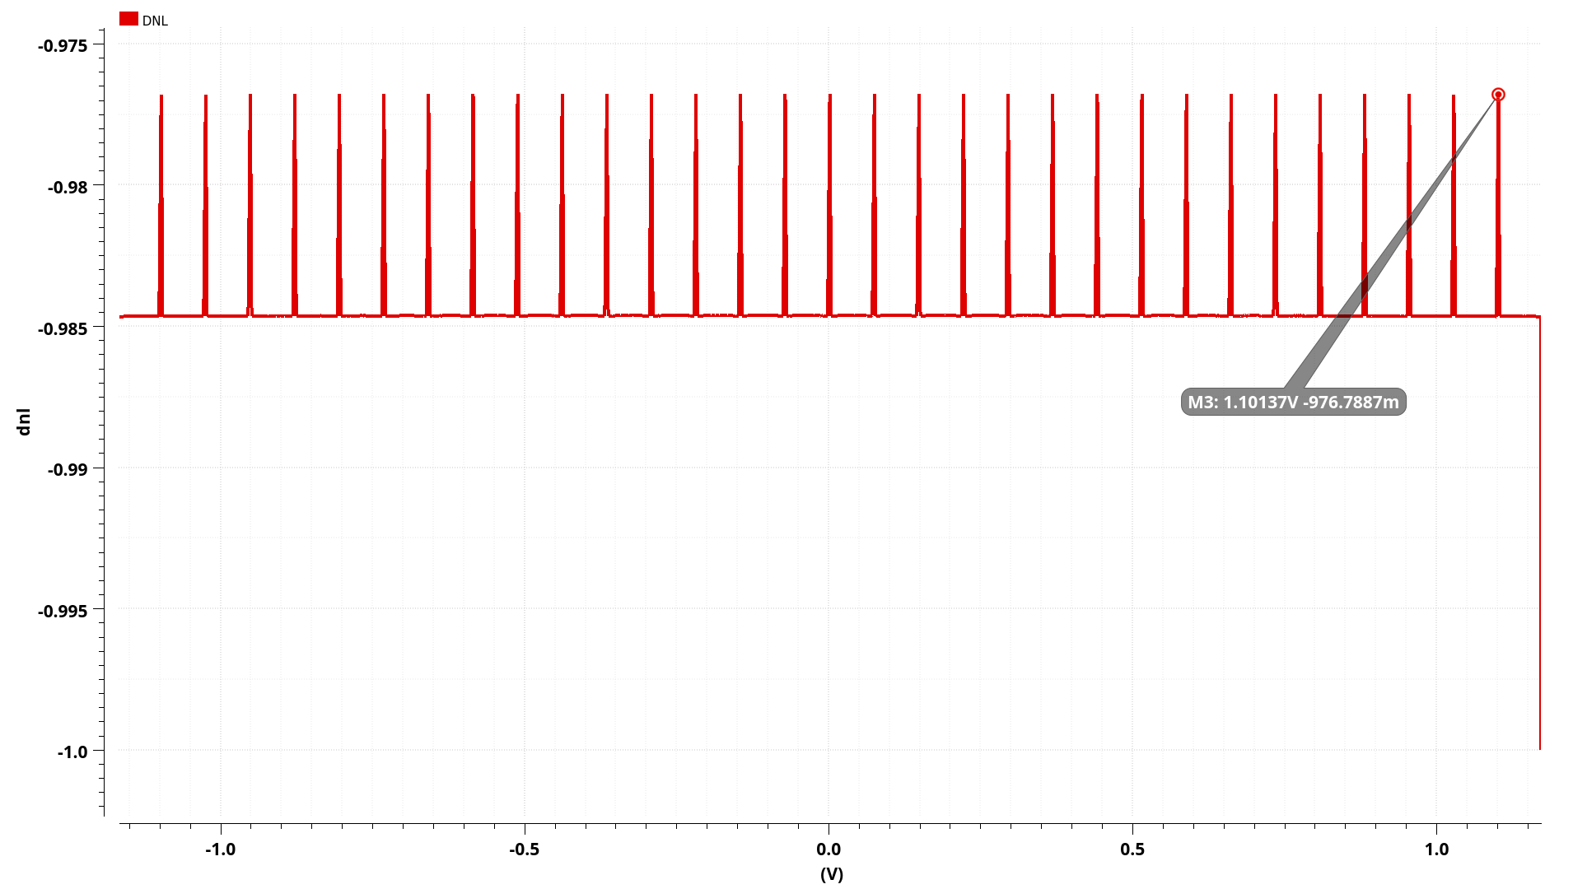
DNL Of DAC
Unfortunately, it is bad

Slide 45
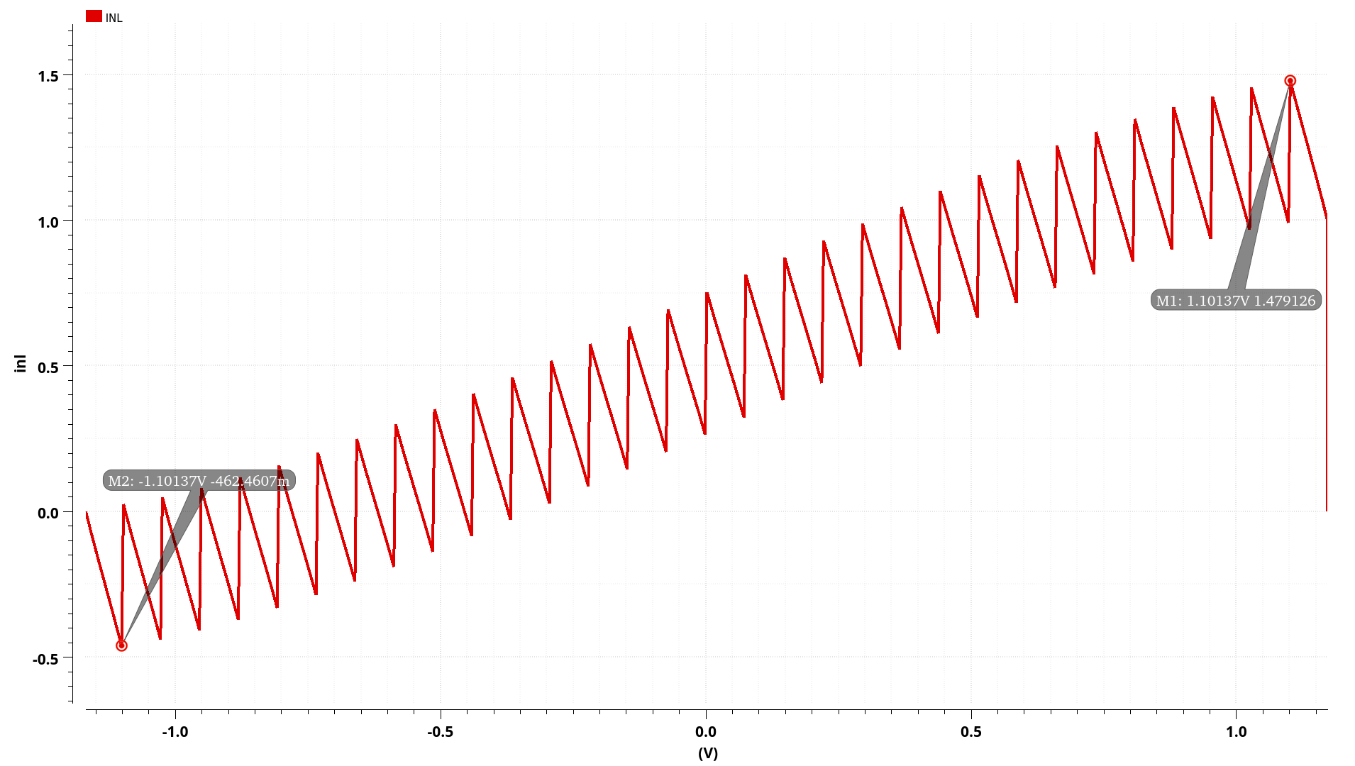
INL Of DAC
Unfortunately, it is bad

Slide 46
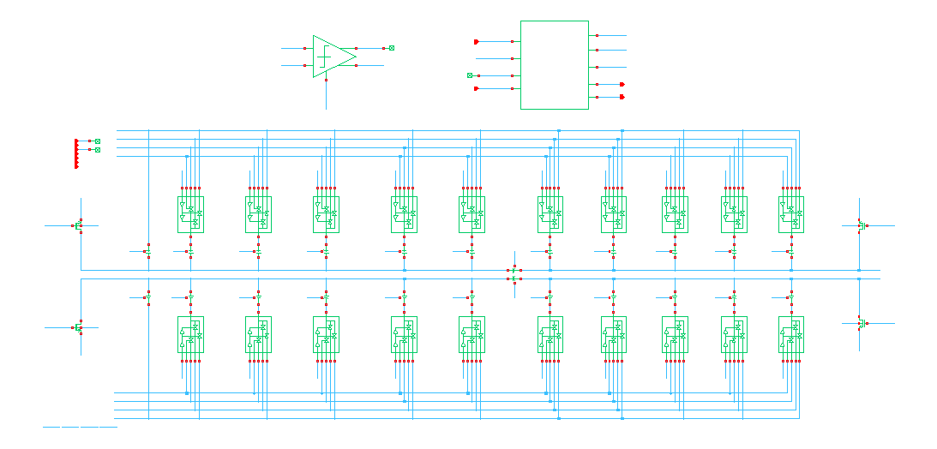
Full System of Synchronous ADC

Slide 47
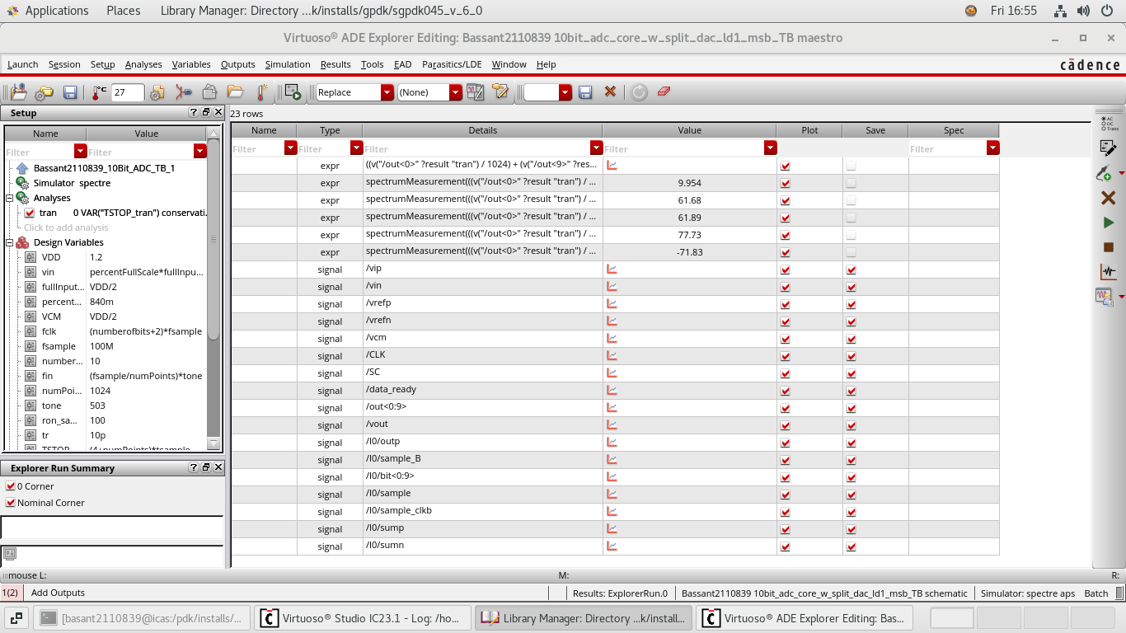
Spectrum Analysis of ADC

Slide 48
THANKS!

